Slide 1
Autonomous Race car Navigation with Reinforcement Learning
Mohammad Jaminur Islam,CS258

Slide 2
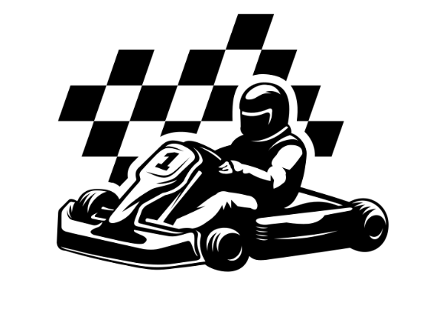
Project Goal
Train an autonomous Racecar agent using reinforcement learning (RL) to navigate a racetrack efficiently.
Leverage image-based observations to learn the continuous action.

Slide 3
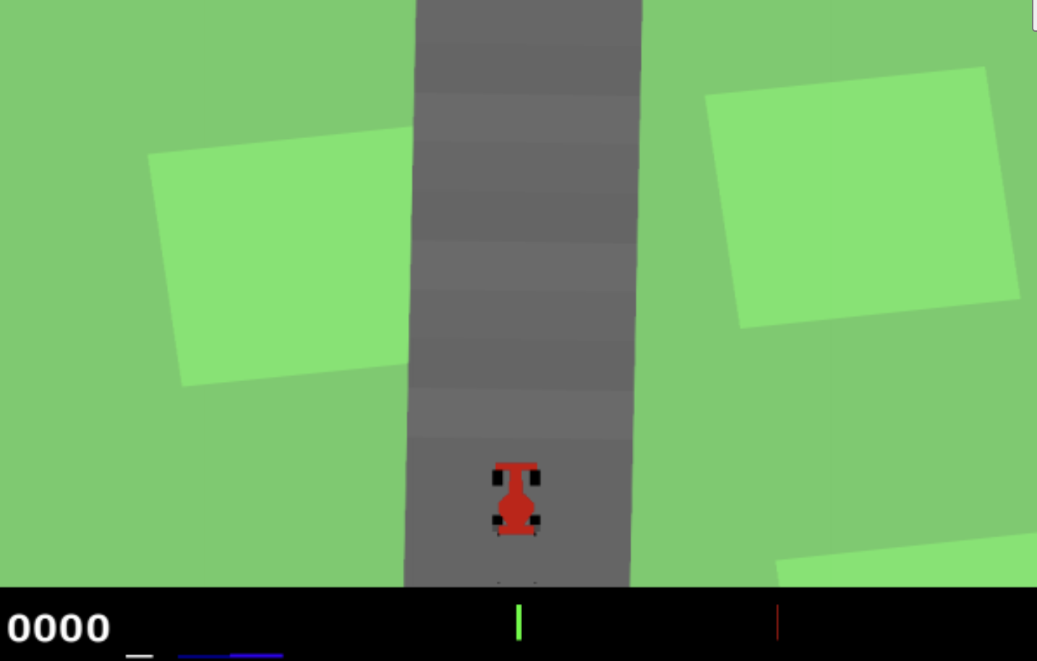
Racecar environment
Environment: Gymnasium race car version 3.
Observation space: Image of shape 96,96,3
Action space: shape of 3, steering in range [-1,1], brake and gas in range (0,1).
Environment dynamic: Not random.
Environment wrapper:
Total 4 frames are considered while taking action.
Reward calibration: A penalty going to the green zone in the track.

Slide 4
Algorithms
Proximal Policy Optimization (PPO)
On-Policy Training: Directly interacts with the environment to iteratively refine the policy network.
Advantage Estimation: Balances immediate and long-term rewards using G(t)=r(t)+γ⋅G(t+1),
Entropy Regularization: Starts with an entropy coefficient of 0.02 to encourage exploration and decays to 0.001.
Policy Updates: Trains the policy network over 3 epochs and the value network over 5 epochs per iteration with a batch size of 256 and learning rate of 5e-4,1e-3.

Slide 5
Algorithms(cont)
Twin Delayed Deep Deterministic Policy Gradient (TD3)
Policy Noise: Adds Gaussian noise with a standard deviation of 0.1 to policy outputs, clipped for stability.
Replay Buffer: Stores up to 10,000 experiences to enable efficient off-policy sampling and reduce overfitting.
Delayed Policy Updates: Updates the policy network every two steps, stabilizing training, while the value network is updated at every iteration.
Optimization Setup: Actor network uses a learning rate of 7e−4, and the critic network uses 1e−4.

Slide 6
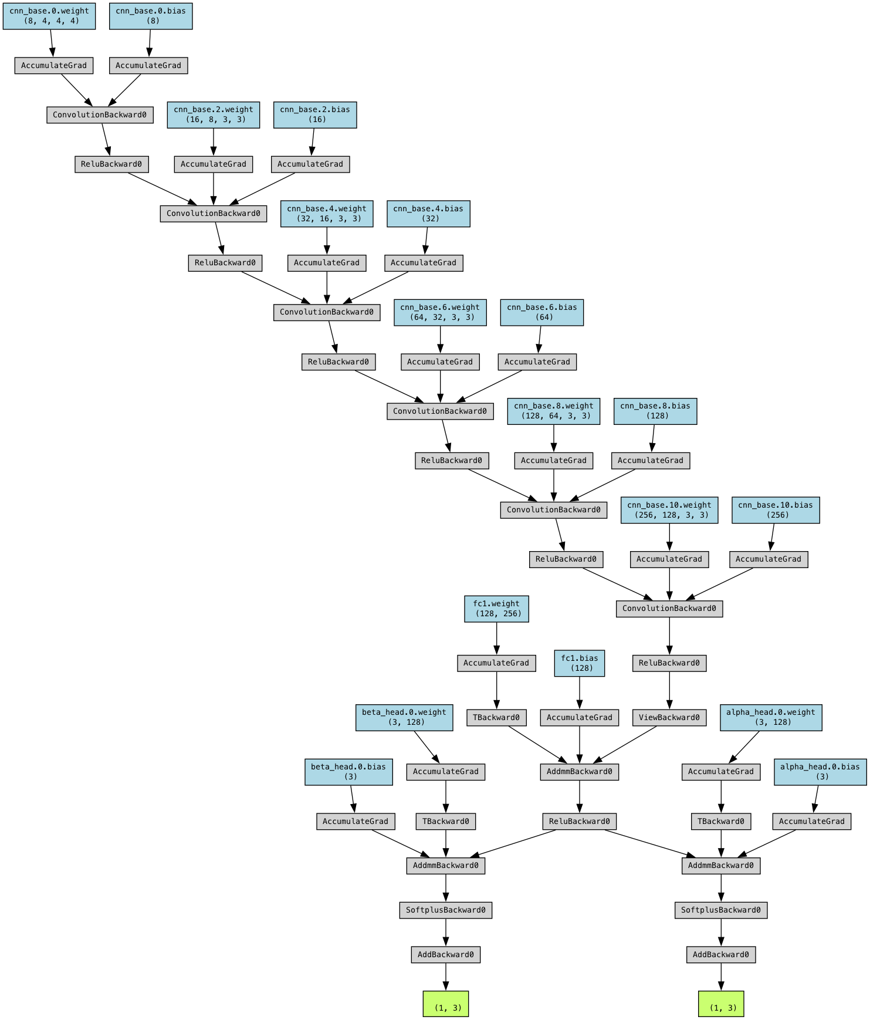
Architecture
6 CNN layer starting from 4*8 to 256 *1 using varying kernel size and strides
Output: alpha, beta
Shape Batch size *3
Fully connected layer 1: 256*128
Fully connected layer 2: 128*3

Slide 7
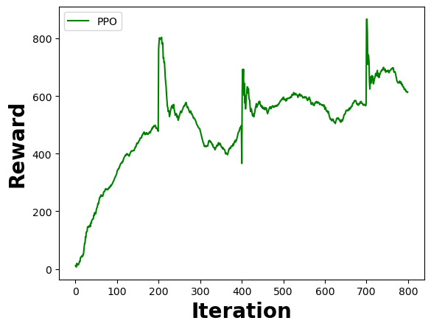
Result

Slide 8
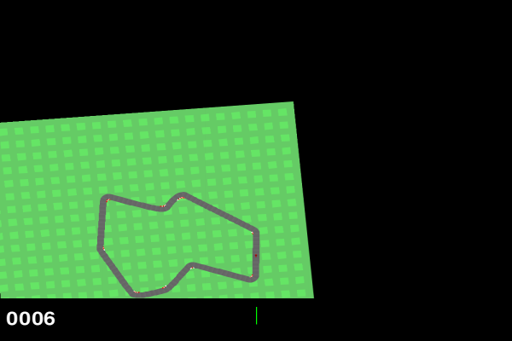
Race car animation

Slide 9
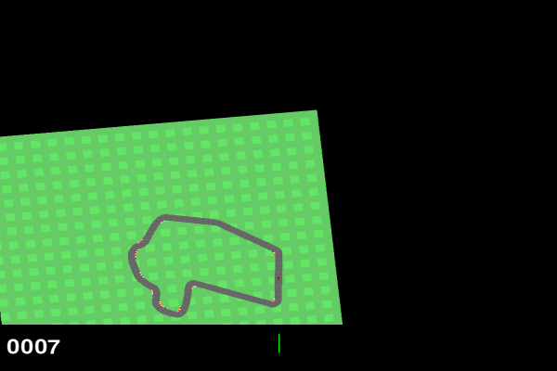
What worked for me and what not
First without combining multiple frames it did not work
Higher lap complete complete percentage suffered a lot as well.
Curricula learning worked magically that helped picked up rewards.

Slide 10
Future scope
Applying memory based models such as LSTM or RNN even transformer to learn more efficiently.
Started working on multiple environments collecting sample trajectories for minibatching. (takes too long to converge or pick up the reward)
For TD3 I faced difficulties tuning the parameters want to explore more about TD3.

Slide 11

Q/A

